Slide 1
OCI API Gateway
Recommended Approach & Architecture
Contributors
Peter Obert – AI and App Integration, API Mgmt. and Process Automation Black Belt
EMEA TE
Apr 2026
Notes:
I would like to thank all the contributors to this workshop: Valeria, Bogdan, Brian, Aishwarya, Milomir and a very special thanks to PM Niall Commiskey for his valuable insights and support.

Slide 3

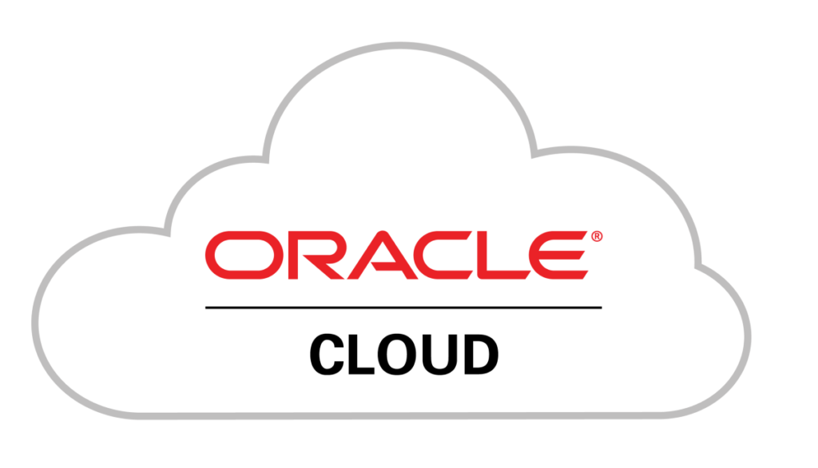
What is OCI API Gateway?
OCI API Gateway is a fully managed, serverless service that publishes APIs with private or public endpoints — with zero infrastructure to manage.
Managed Service
Serverless
Multi-Backend
Fully managed by OCI — no servers to provision, patch, or scale
Pay per request model with automatic scaling to any traffic volume
Route to Functions, Compute, Kubernetes, Object Storage, or HTTP backends
Primary recommendations for API management on OCI

Slide 4
Key Capabilities
Routing
Auth & AuthZ
Route to Functions, HTTP backends, Object Storage, or Stock Responses
JWT validation, custom OCI Function authorizers, OAuth 2.0
Rate Limiting
Request Transform
Control request rates at deployment or route level
Modify headers, query params, and body on the fly
CORS Support
Observability
Built-in Cross-Origin Resource Sharing configuration
Native integration with OCI Logging, Metrics & Monitoring

Slide 5
Recommended Architecture Pattern
Client
OCI DNS
OCI API Gateway
Backend
▶
▶
▶
Web / Mobile / API Consumer
Name resolution
Routing · Auth · Rate Limit
Functions · Compute · OKE · HTTP
Supporting OCI Services
OCI IAM / JWT
OCI Certificates
OCI Logging
OCI Monitoring
Layer | OCI Service
DNS | OCI DNS
TLS / Certs | OCI Certificates
API Management | OCI API Gateway
Auth | OCI IAM / IDCS / Custom JWT
Compute / Logic | OCI Functions or OKE
Observability | OCI Logging, APM, Monitoring, OCI Log Analytics API GW Dashboards

Slide 6
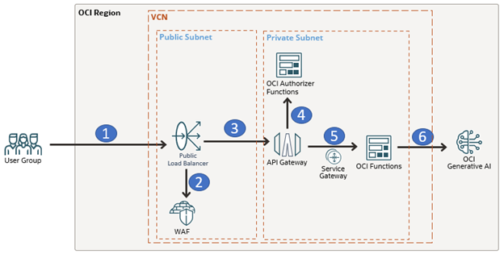
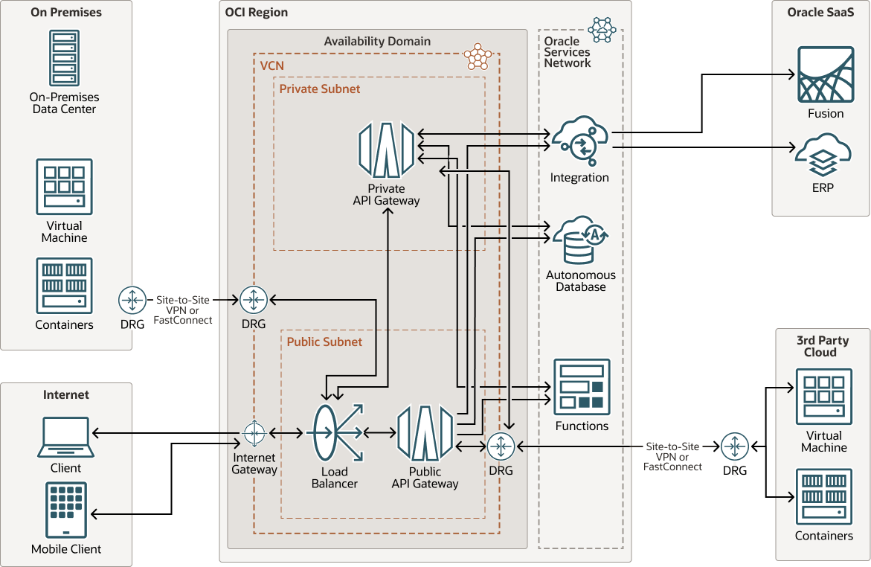
Deployment Models
Public API Gateway
Private API Gateway
External Facing
Internal / Intranet
Accessible over the public internet
Best for external-facing / consumer APIs
Assigns a public IP and hostname
Supports custom domain with OCI Certs
Accessible only within a VCN
Best for internal microservices
No public exposure — zero attack surface
Ideal for backend-to-backend communication

Slide 7
Best Practices
VCN-Native Endpoints
OCI Functions as Authorizers
01
02
Place gateway in a dedicated subnet with proper Security Lists & NSGs
Use custom Function authorizers for API keys and custom token logic
Enable Logging
Usage Plans
03
04
Send access logs to OCI Logging for auditing and debugging
Control and monetize API consumption per subscriber
Separate by Environment
Apply Rate Limiting Early
05
06
Use distinct API deployments for dev / staging / production
Protect backends from traffic spikes at the gateway level

Slide 8
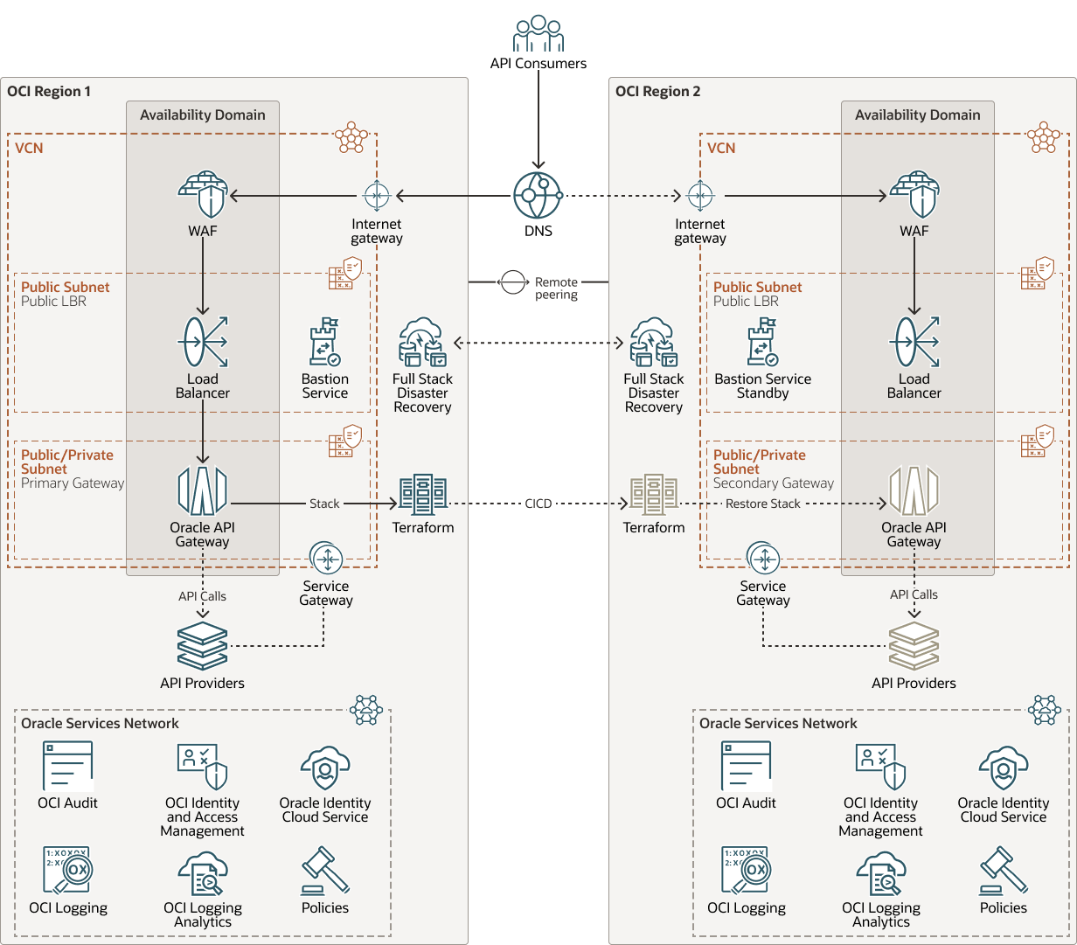
Recommendations Summary
For most OCI use cases, the native OCI API Gateway is the clear recommendation.
✓
Serverless — zero infrastructure to manage
✓
Deep OCI integration out of the box
✓
Pair with OCI Functions for custom authorizers & logic
✓
Pair with OCI IAM / IDCS for enterprise identity
✓
Scale to production traffic automatically
✓
Use Usage Plans to control and monetize API access
OCI API Gateway | Recommended API Management Platform on Oracle Cloud

Slide 9
References
Product Capabilities
🔗 OverviewOracle's primary documentation covering the service overview, IAM integration, and capabilities.
🔗 HomeThe top-level documentation hub for the API Gateway service.
🔗 ConceptsCovers public vs. private gateways, usage plans, rate limits, quotas, subscribers, and entitlements.
🔗 Creating an API GatewayStep-by-step guide for creating public and private gateways via CLI and Console.
🔗 Limiting the Number of Requests to API Gateway Back EndsOfficial documentation on rate limiting policies.
🔗 OCI API Gateway - Release Notes History of features including JWT auth, OCI Certificates integration, response caching, CORS, and Usage Plans.
Reference Architectures
🔗OCI API GatewayOracle reference architecture for connecting multi-cloud microservices via API Gateway.
🔗 Disaster Recovery Reference Architecture — OCI API Gateway Covers HA, cross-region DR, NSGs, Security Lists, and deployment synchronization.

Slide 10
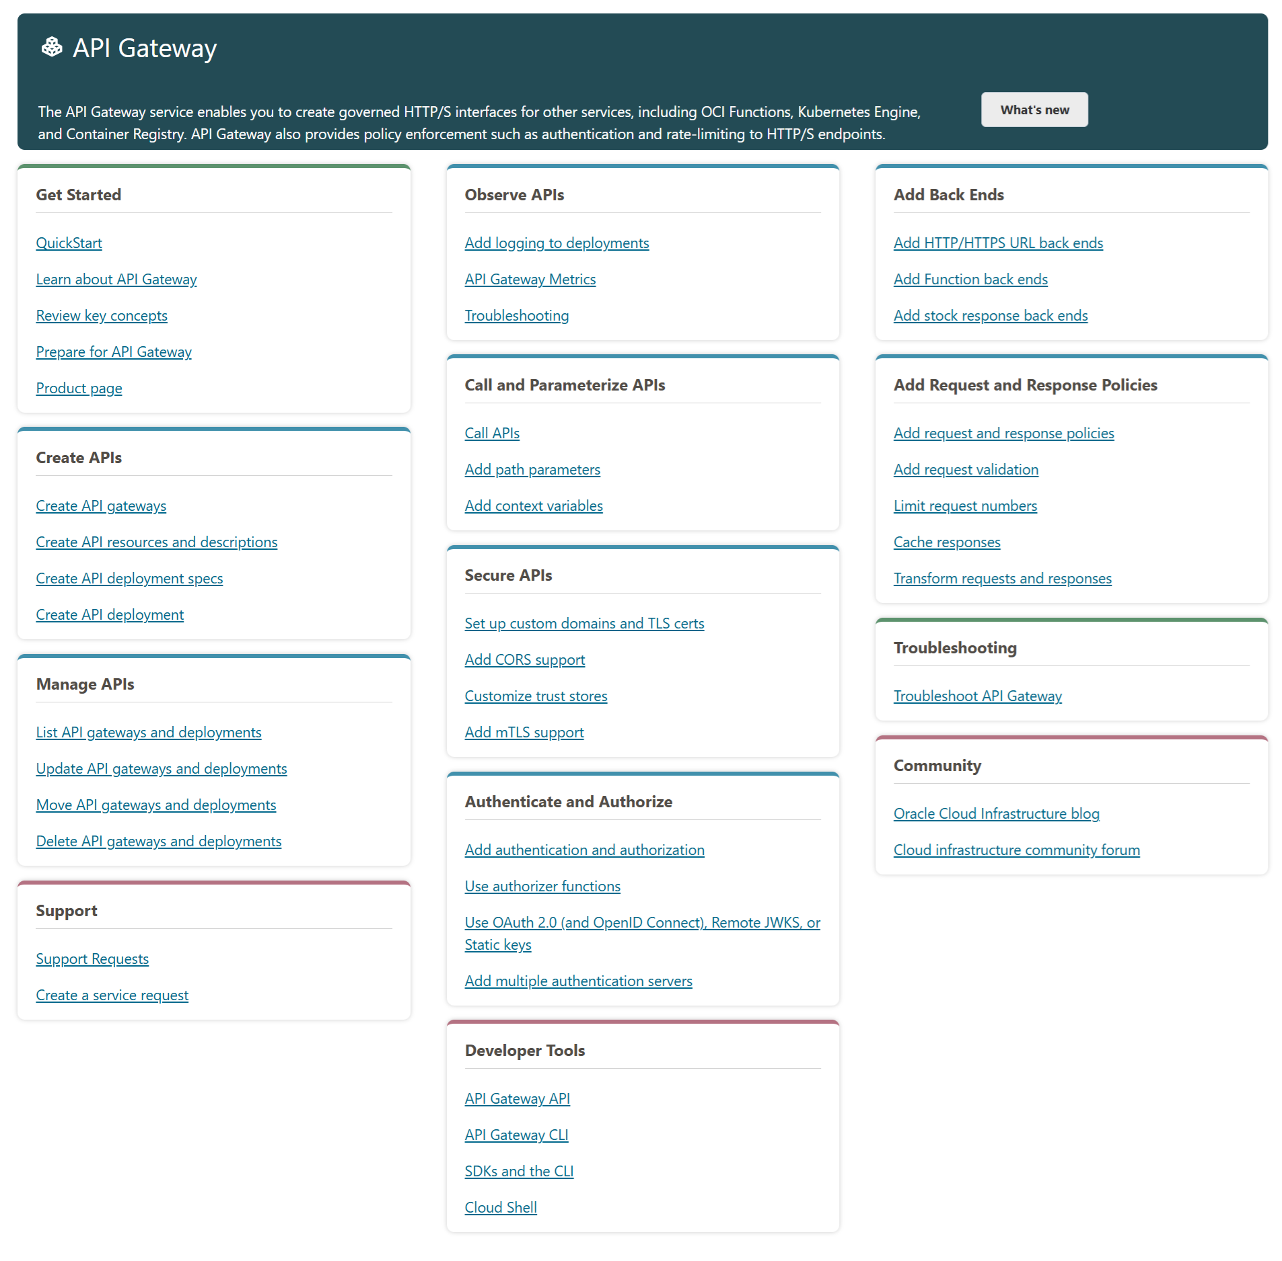
Learn more
Visit OCI API Management

Slide 11
Thank you

